Slide 1
Computational Complexity

Slide 2
What’s important about Computational Complexity?

Slide 3
Why complexity?
We have to decide between algorithm A and algorithm B
We have a dataset for benchmarking algorithms with about 1,000 rows
What should we do?
 | Algo A | Algo B
Time on lab data | 5s | 30s

Slide 4
Why complexity?
We have to decide between algorithm A and algorithm B
We have a dataset for benchmarking algorithms with about 1,000 rows
What should we do?
This depends on what kinds of data the algorithms will be given in production
What if we’ll be running it on 100k rows?
 | Algo A | Algo B
Time on lab data | 5s | 30s

Slide 5
Why complexity?
We have to decide between algorithm A and algorithm B
We have a dataset for benchmarking algorithms with about 1,000 rows
What should we do?
This depends on what kinds of data the algorithms will be given in production
What if we’ll be running it on 100k rows?
What if we had a formula that told us the runtime for different size inputs?
 | Algo A | Algo B
Time on lab data | 5s | 30s

Slide 6

Why complexity?
We have to decide between algorithm A and algorithm B
What should we do?
What if we had a formula that told us the runtime for different size inputs?
$t_{a}\left(n\right)=5∗{\left(\frac{n}{1000}\right)}^{2}$
$t_{b}\left(n\right)=29+\left(\frac{n}{1000}\right)$
 | Algo A | Algo B
1k | 5s | 30s

Slide 7

Why complexity?
We have to decide between algorithm A and algorithm B
What should we do?
What if we had a formula that told us the runtime for different size inputs?
$t_{a}\left(n\right)=5∗{\left(\frac{n}{1000}\right)}^{2}$
$t_{b}\left(n\right)=29+\left(\frac{n}{1000}\right)$
Now we can know the runtime for any size input
 | Algo A | Algo B
1k | 5s | 30s
10k | 500s | 39s

Slide 8
Why complexity?
We have to decide between algorithm A and algorithm B
What should we do?
What if we had a formula that told us the runtime for different size inputs?
$t_{a}\left(n\right)=5∗{\left(\frac{n}{1000}\right)}^{2}$
$t_{b}\left(n\right)=29+\left(\frac{n}{1000}\right)$
Now we can know the runtime for any size input
 | Algo A | Algo B
1k | 5s | 30s
10k | 500s | 39s
100k | 13.9 hours | 49s

Slide 9
Complexity Defined
Complexity: An algorithm’s complexity is a measure of the resources it uses

Slide 10
Complexity Defined
Complexity: An algorithm’s complexity is a measure of the resources it uses
Most common is time complexity
In a few weeks, we will discuss space complexity (memory use)

Slide 11
Complexity Defined
Complexity: An algorithm’s complexity is a measure of the resources it uses
Most common is time complexity
In a few weeks, we will discuss space complexity (memory use)
Time complexity can be measured in several ways
Wall clock measures amount of time that passes while the algorithm runs
Imminently useful
However, sensitive to details about hardware and implementation like processor core speed and parallelization

Slide 12
Complexity Defined
Complexity: An algorithm’s complexity is a measure of the resources it uses
Most common is time complexity
In a few weeks, we will discuss space complexity (memory use)
Time complexity can be measured in several ways
Wall clock measures amount of time that passes while the algorithm runs.
Imminently useful
However, sensitive to details about hardware and implementation like processor core speed and parallelization
Compute time measures the computations made during the algorithm’s execution
ex: number of comparisons, processor cycles
Relevant across different hardware setups and implementations

Slide 13
Complexity Is Important!
A model’s time/space complexity can be just as important as its performance
What are some examples of when complexity matters?
Next, we’ll explore how to compare compute times with big-O notation

Slide 14
Introducing Big-O Notation

Slide 15
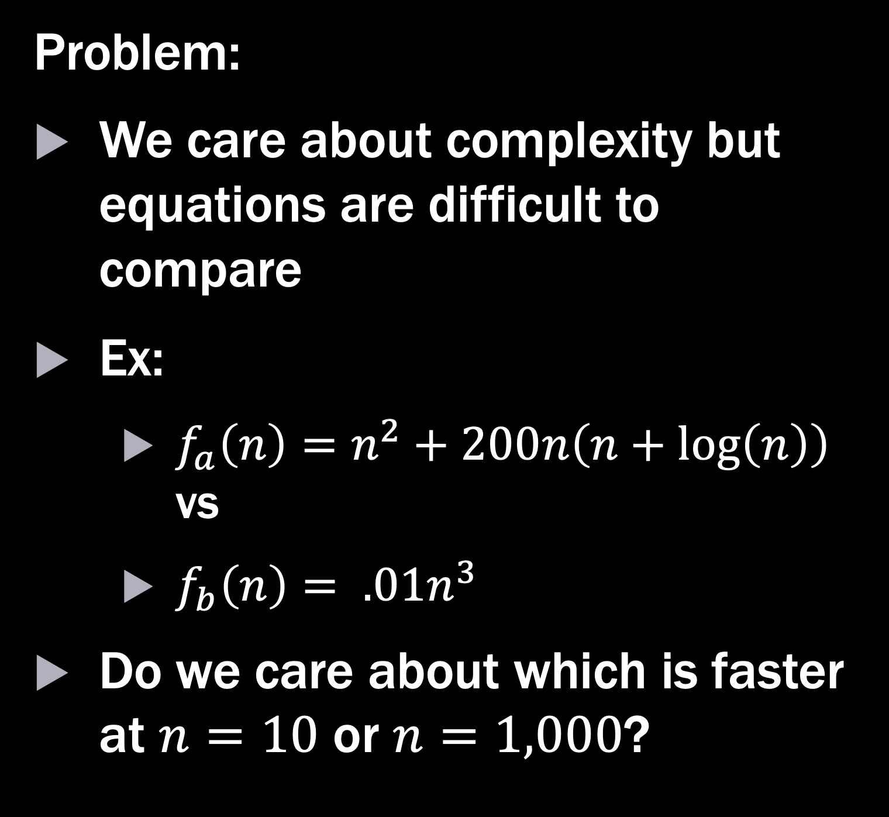
Big-O
Problem:
We care about complexity but equations are difficult to compare
Ex:
$f_{a}\left(n\right)=n^{2}+200n\left(n+\log\left(n\right)\right)$ vs
$f_{b}\left(n\right)= .01n^{3}$
Do we care about which is faster at $n=10$ or $n=1,000$?

Slide 16
Big-O
Problem:
We care about complexity but equations are difficult to compare
Ex:
$f_{a}\left(n\right)=n^{2}+200n\left(n+\log\left(n\right)\right)$ vs
$f_{b}\left(n\right)= .01n^{3}$
Do we care about which is faster at $n=10$ or $n=1,000$?
Solution
Big-O notation simplifies comparisons of computational resources

Slide 17
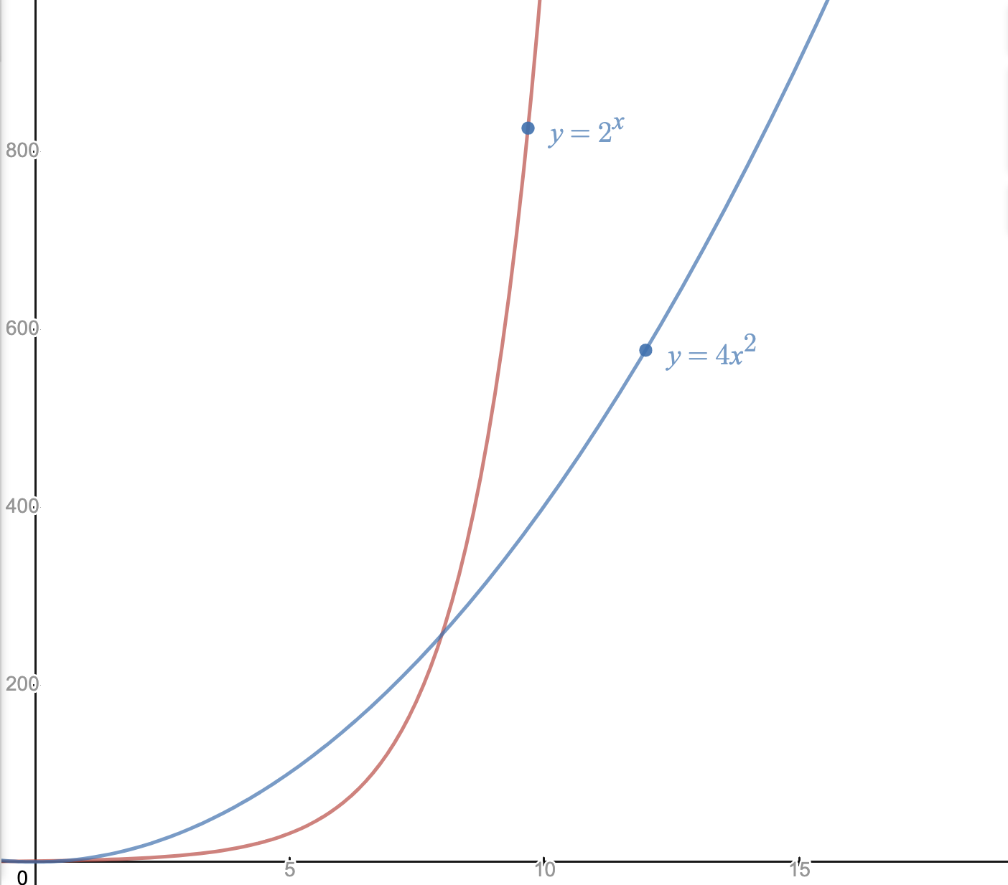

Big-O
Idea
At scale, the most important comparison is the overall growth behavior
For an equation like $2^{n}+4n^{2}$, which part is going to matter as $n→∞$?

Slide 18


Big-O
Idea
At scale, the most important comparison is the overall growth behavior
For an equation like $2^{n}+4n^{2}$, which part is going to matter as $n→∞$?
Complexity equations
$$2n!$$
$$2^{n}+4n^{2}$$
$$n^{100}+3$$
$$n^{2}+n$$

Slide 19
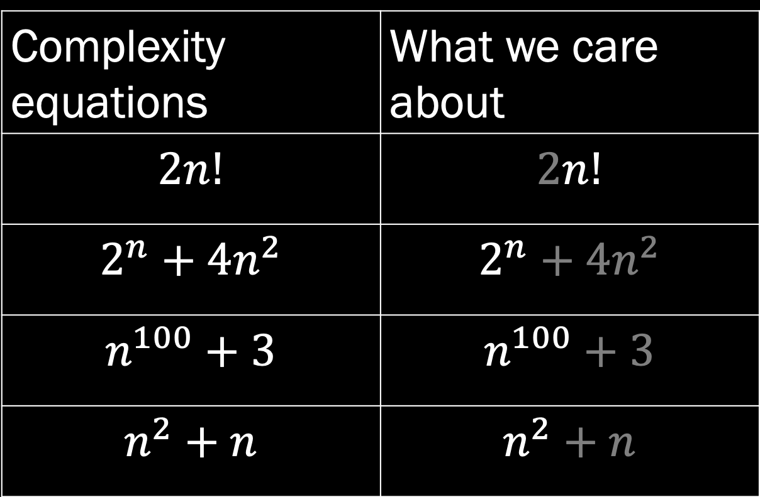
Big-O
Idea
At scale, the most important comparison is the overall growth behavior
For an equation like $2^{n}+4n^{2}$, which part is going to matter as $n→∞$?
Complexity equations | What we care about
$$2n!$$ | $$2n!$$
$$2^{n}+4n^{2}$$ | $$2^{n}+4n^{2}$$
$$n^{100}+3$$ | $$n^{100}+3$$
$$n^{2}+n$$ | $$n^{2}+n$$

Slide 20

Big-O
Definition
If there exists a $k$ and $g(n)$ such that$\lim_{n→∞}{f\left(n\right)<kg(n)}$
Then $f\left(n\right)=O(g\left(n\right))$

Slide 21
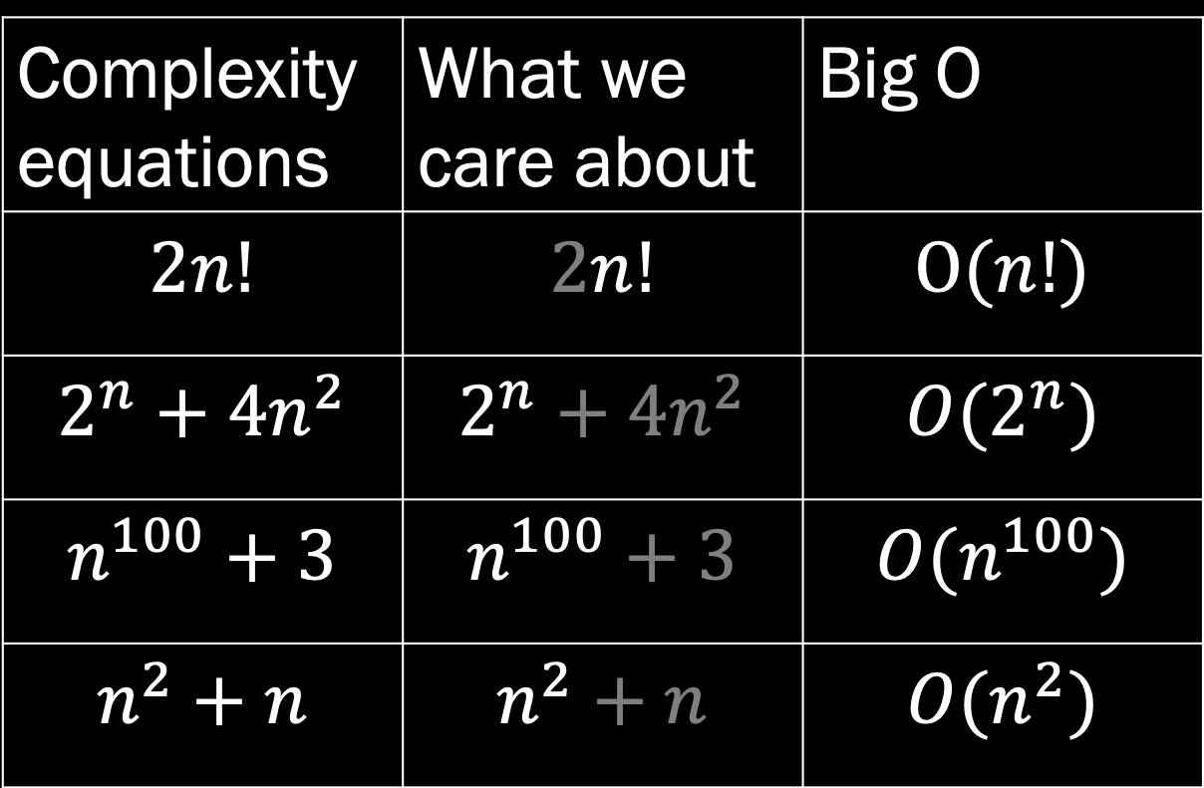
Big-O
Definition
If there exists a $k$ and $g(n)$ such that$\lim_{n→∞}{f\left(n\right)<kg(n)}$
Then $f\left(n\right)=O(g\left(n\right))$
Complexity equations | What we care about | Big O
$$2n!$$ | $$2n!$$ | $$O(n!)$$
$$2^{n}+4n^{2}$$ | $$2^{n}+4n^{2}$$ | $${O(2}^{n})$$
$$n^{100}+3$$ | $$n^{100}+3$$ | $$O(n^{100})$$
$$n^{2}+n$$ | $$n^{2}+n$$ | $${O(n}^{2})$$

Slide 22
Common classes of functions
Name | Notation
Constant | O(1)
Logarithmic | O(log(n))
Linear | O(n)
Quadratic | O(n^2)
Polynomial | O(n^3), O(n^4), etc.
Exponential | O(2^n)
Source

Slide 23
Finding Big-O

Slide 24
Using heuristics to find Big-O
Heuristic workflow
Find expression
Approximate number of basic operations in worst case scenario
Simplify expression
Only keep highest order term
Discard constants

Slide 25
Heuristics Cheat Sheet
Coefficients: Drop any constants / coefficients
O(3N) is reduced to O(N)
Simple statements: O(1)
print()
dict[‘key’] = value
Loops: O(inside loop) * number of iterations
Consecutive statements: Most complex statement on same indent
Conditional statements: O(condition + longest branch)
Keep the furthest left term: 2^n >> n^5 >> n^3 >> n^1 >> n lg(n) >> lg(n) >> 1

Slide 26

Finding Big-O (you try it)
Find the big-O complexity for:
$$f\left(n\right)=n(2n+\sin\left(n\right))$$

Slide 27

Finding Big-O
Find the big-O complexity for:
$$f\left(n\right)=n\left(2n+\sin\left(n\right)\right)$$
$→2n^{2}+n\sin{(n)}$ [simplify]
$→2n^{2}$ [keep highest order term]
$→n^{2}$ [discard coefficients]
$$f\left(n\right)=O(n^{2})$$

Slide 28
Takeaways
Computational complexity allows us to evaluate an algorithm’s resource use
Big-O notation is a tool for summarizing complexity in a useful way
The Big-O complexity for an algorithm can be solved formally using proofs or informally using heuristics

Slide 30
Extras

Slide 31

Method 2: Proof
Proof
Show that there exists a $k_{0}$ and an $n_{0}$ such that
For all $n>n_{0}$, $k_{0}g\left(n\right)>f(n)$
Then $f\left(n\right)=O(g\left(n\right))$

Slide 32

Method 2 (you try it)
Use a proof to find the big-O complexity of:
$$f\left(n\right)= \frac{1}{2}\left(2^{n}\right)−3n$$
Let $g\left(n\right)=2^{n}$
$$k2^{n}> \frac{1}{2}\left(2^{n}\right)−3n$$
$$k> \frac{1}{2}−\frac{3n}{2^{n}}$$
True for $k=.5, n>3$, therefore $f\left(n\right)=O(2^{n})$ $∎$

